Slide 1
EC544 Team 1 – Challenge 2
Abdulaziz Alhassan, Damini Ashok Chopra, Konstantino Sparakis,
Xinzhu Xu, Wenyng Zhang

Slide 2
Design Decisions
In Challenge 1 we decided to save everything to a MySql database.
For Challenge 2 we use php to manipulate Html, MySql, and JavaScript to design a interface for data representation.

Slide 3



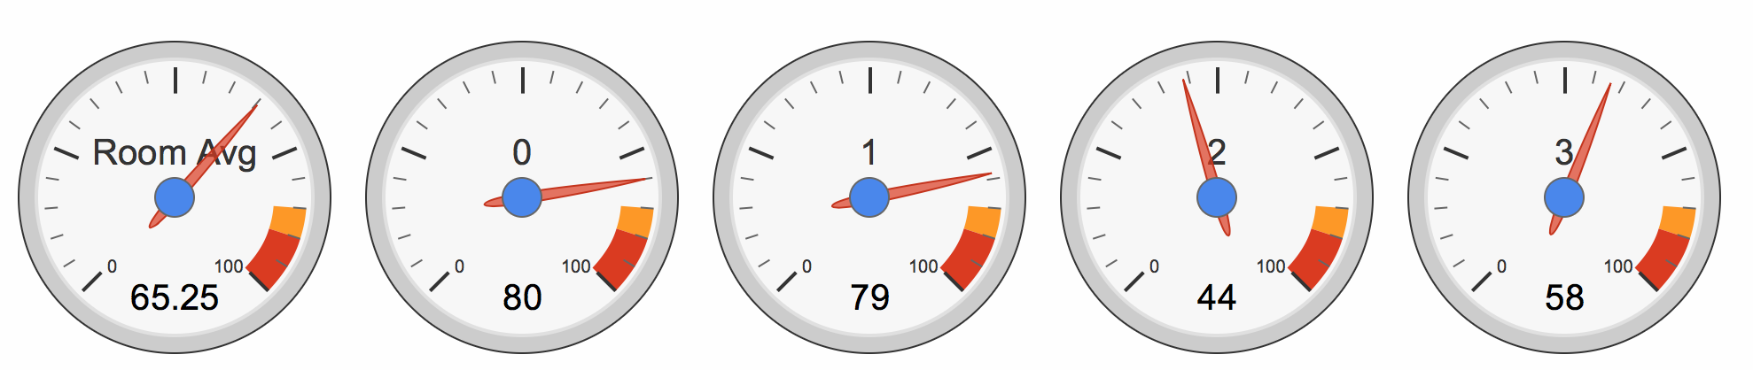
Technologies
Xampp
MySql
Javascript
Php
Html/css
Google Chart API
Rickshaw Graphing API

Slide 4

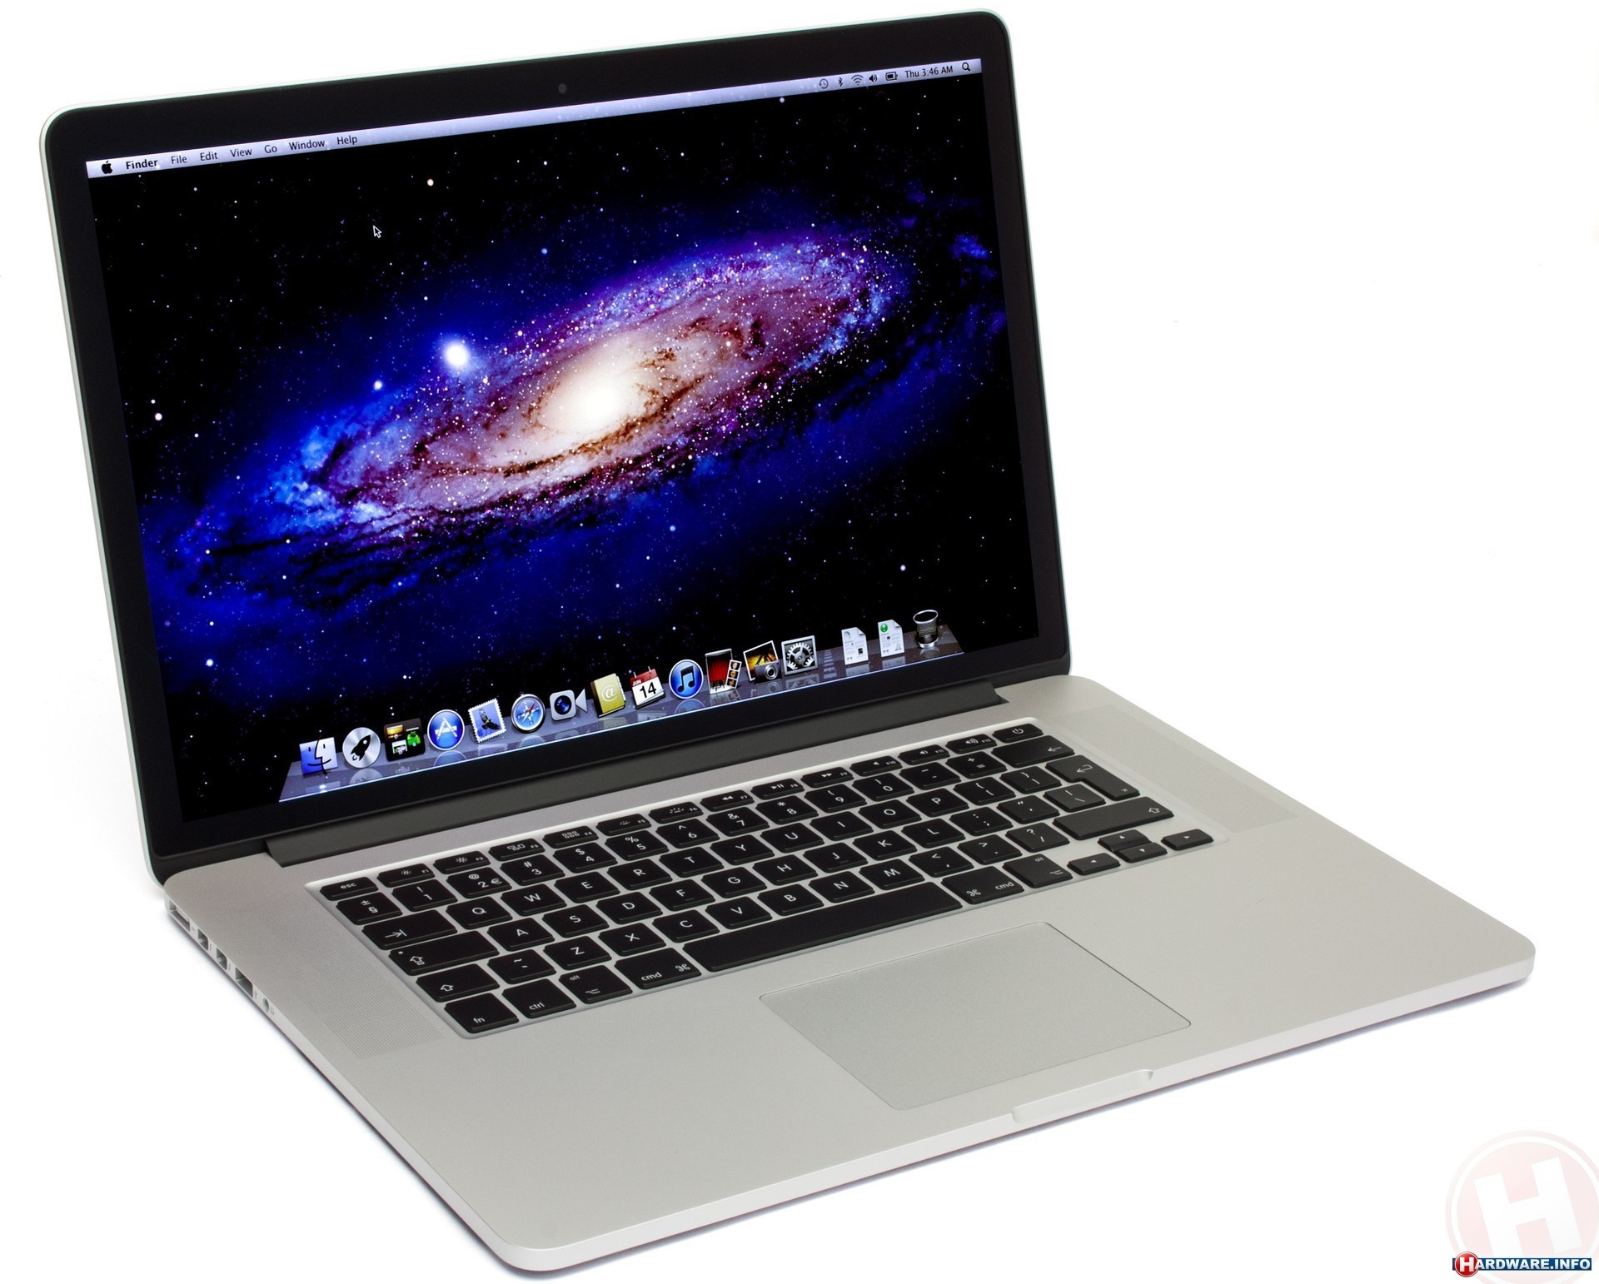

Data Flow
Rickshaw Graphing API
Google Chart API
JavaScript
Html
Database
Css

Slide 5
Challenges
Learning Rickshaw Graph API
Learning Google Graph API
Creating a system to detect and display live data or display demo for demonstration purpose's.
The ability for the code to adapt to any number of spots.
Working on the tranceiving mechanism of sunspot (handshake).
Threading for the future tasks (possible solution for the issues with handshaking)

